Slide 1

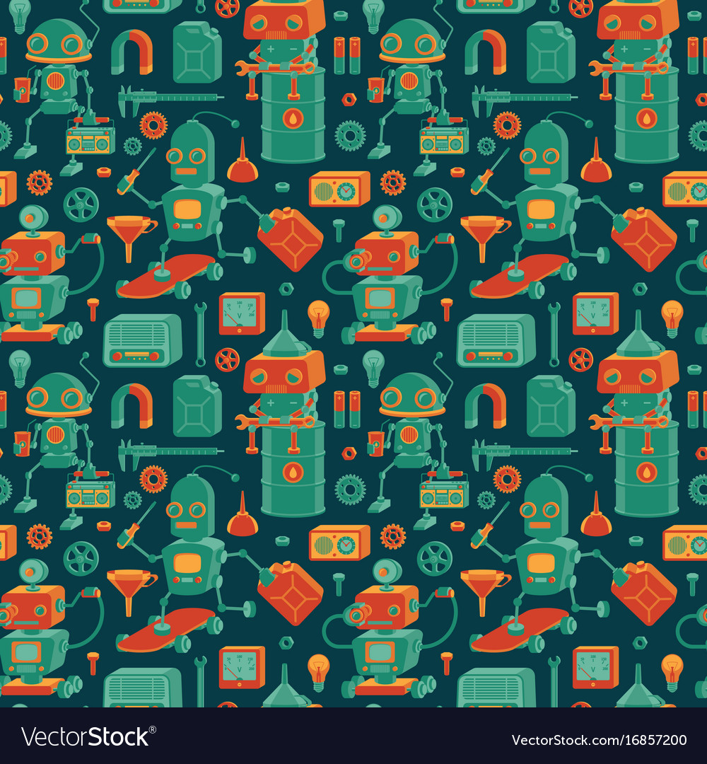

Machine
Vs.
Human

